Slide 1


Does culture moderate relationships between brooding and symptoms of depression and PTSD?
Jolane Abrams & Akshanth Srivatsa
BIS15L
March 2023

Slide 2
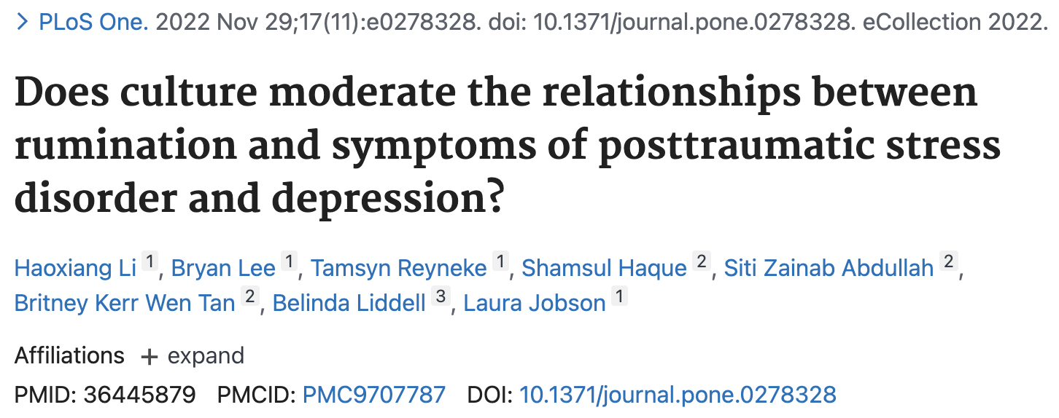

Slide 3
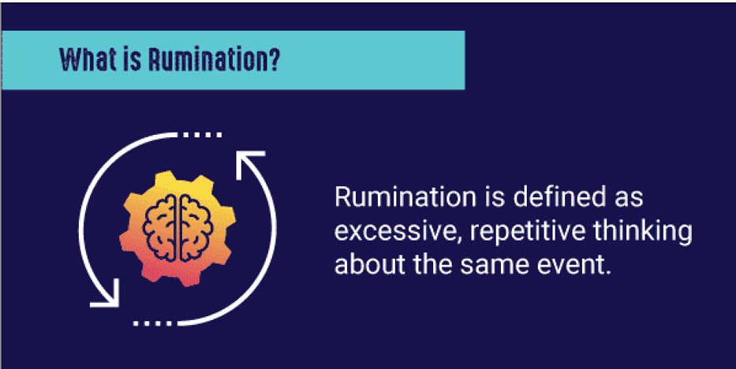
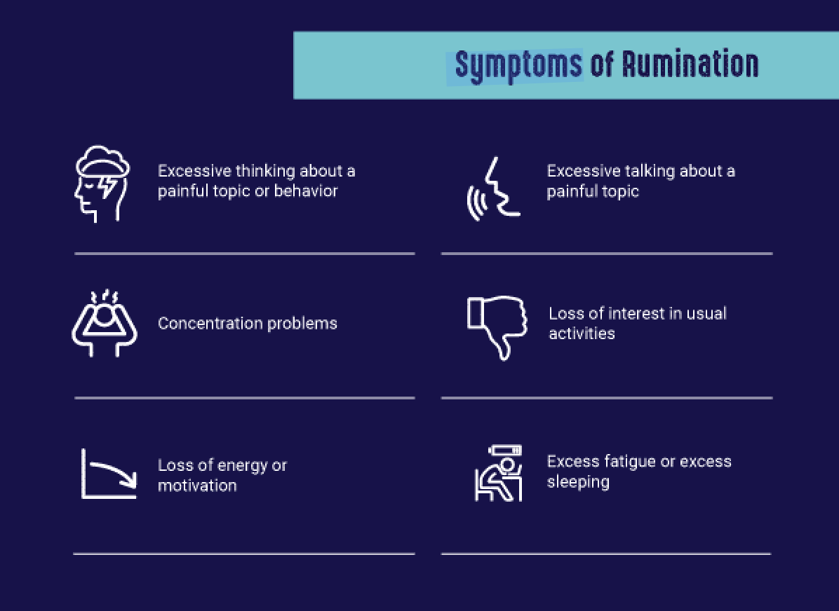
https://www.therecoveryvillage.com/mental-health/rumination/
Brooding rumination leads to negative moods and negative opinions of oneself. Brooding can also lead to substance abuse, depression, and anxiety.

Slide 4
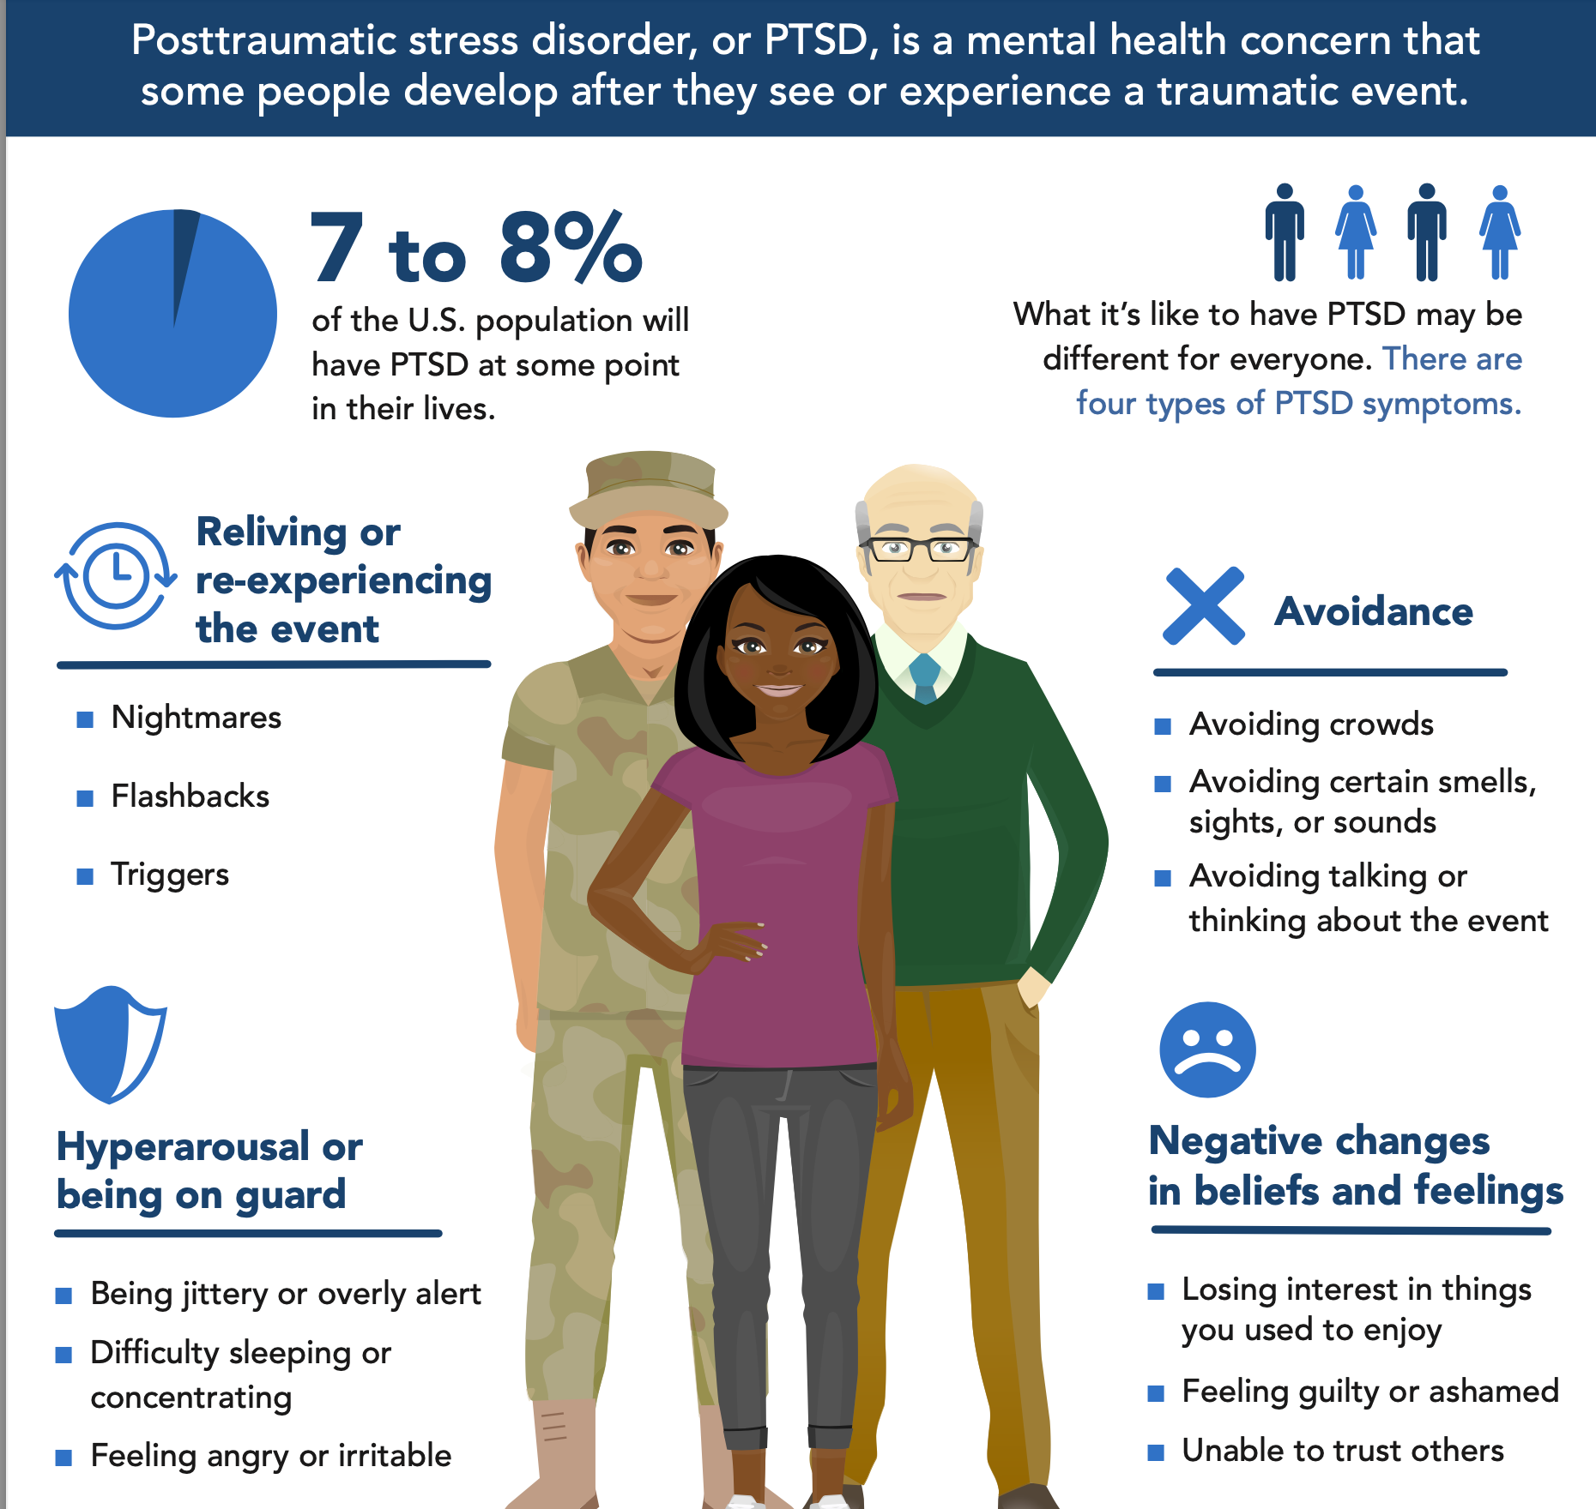
https://www.ptsd.va.gov/publications/print/NCPTSD-Symptoms-of-PTSD-Infographic.pdf

Slide 5
Data available online at https://osf.io/g6h8a/
2 data sets: depression and PTSD
Depression : tidy
PTSD : needed some cleanup, nothing major

Slide 6

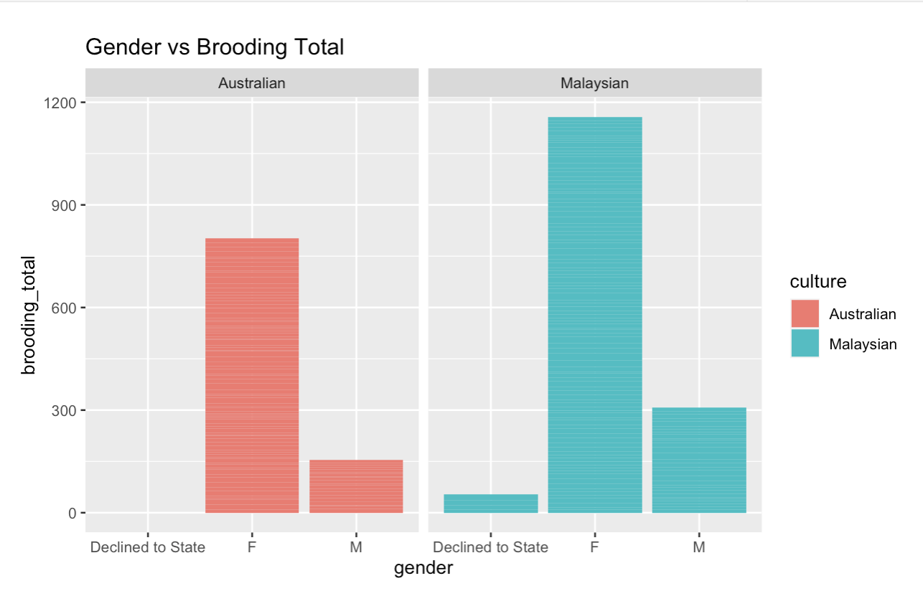



How Does Gender Relate to Between-Culture Brooding Scores?

Slide 7
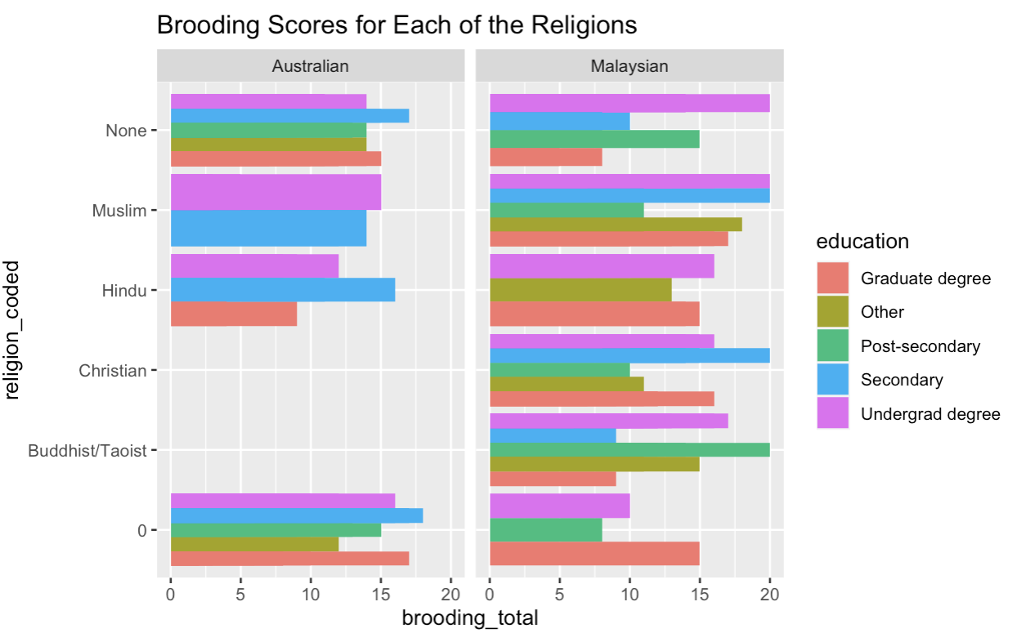
How do Religion and Education Relate to Brooding scores Between Cultures?

Slide 8
Looks impressive, but too complicated.
Is there a better way to graph this?

Slide 9
How does each religion relate to Brooding scores and Education levels?

Slide 10
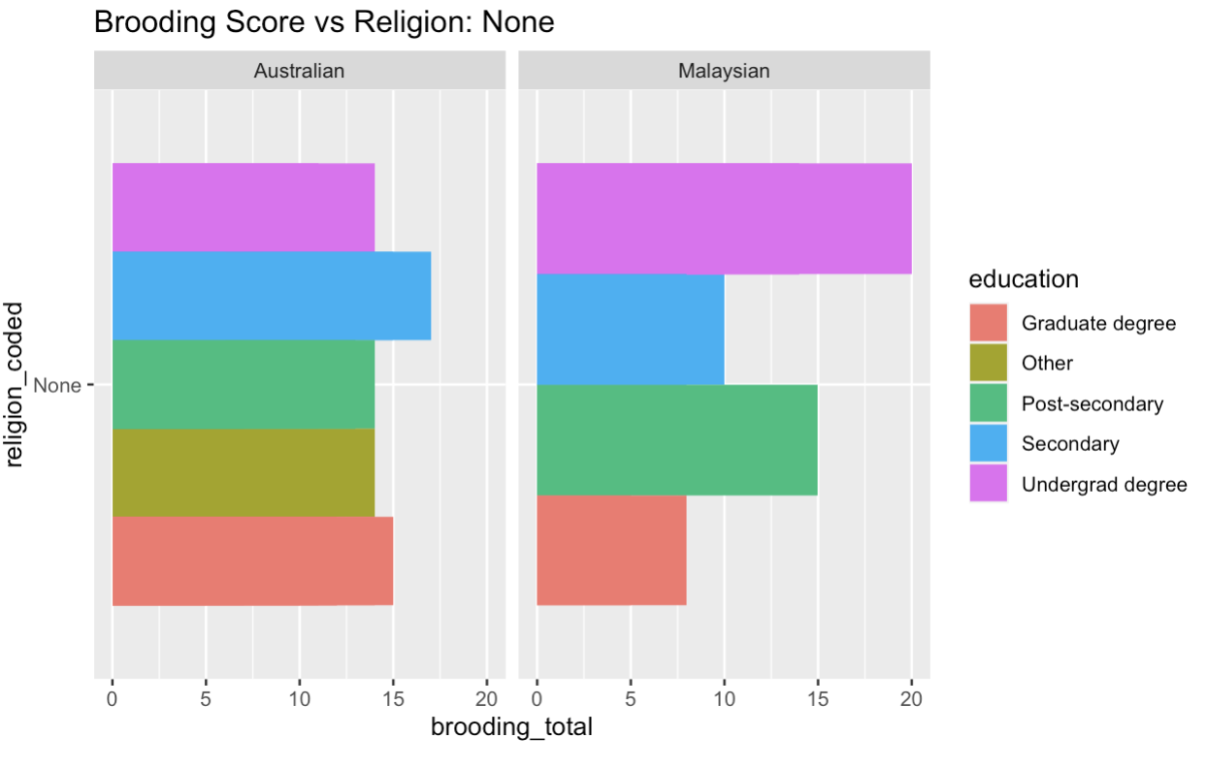
No Religion, Education & Brooding*
*Only graphed Religions with differences of brooding scores

Slide 11
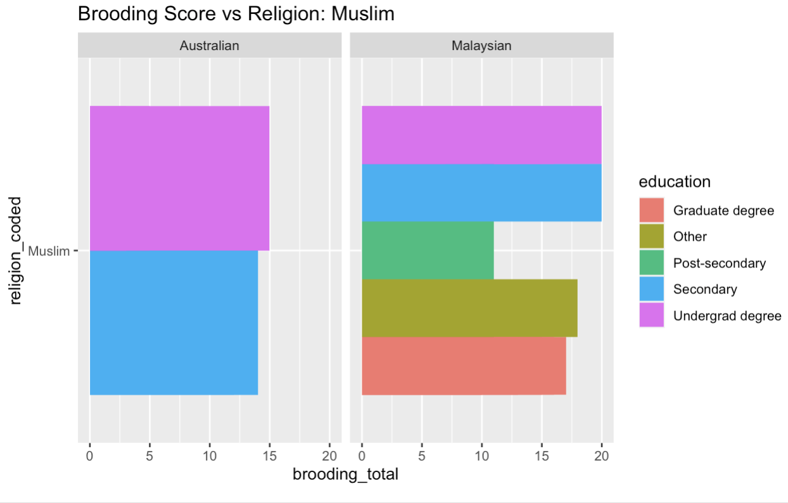
Muslim, Education & Brooding

Slide 12
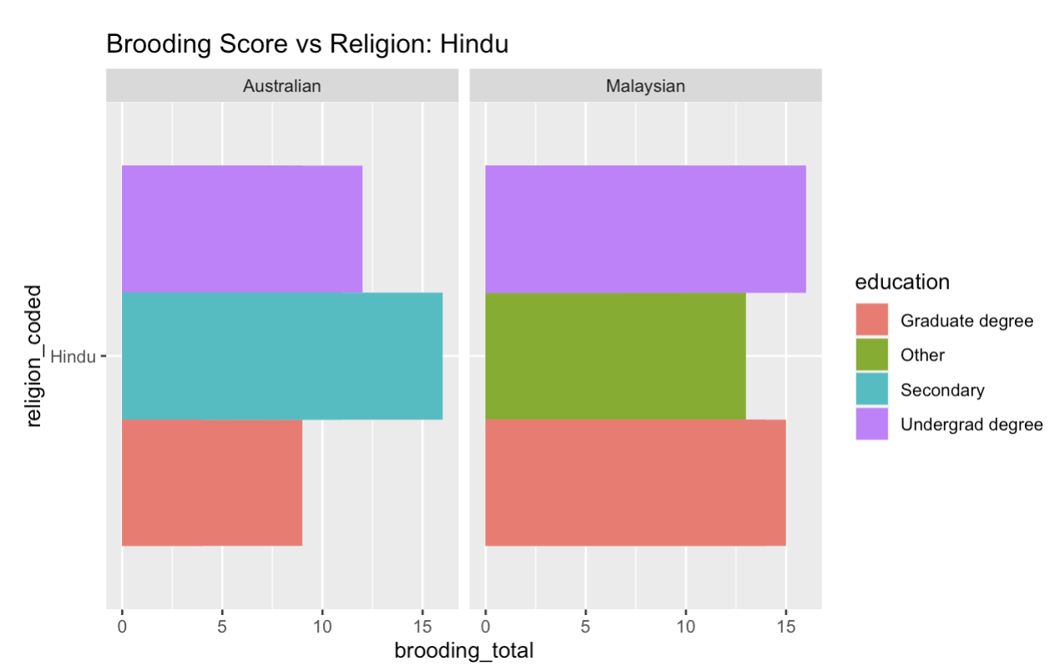
Hindu, Education & Brooding

Slide 13
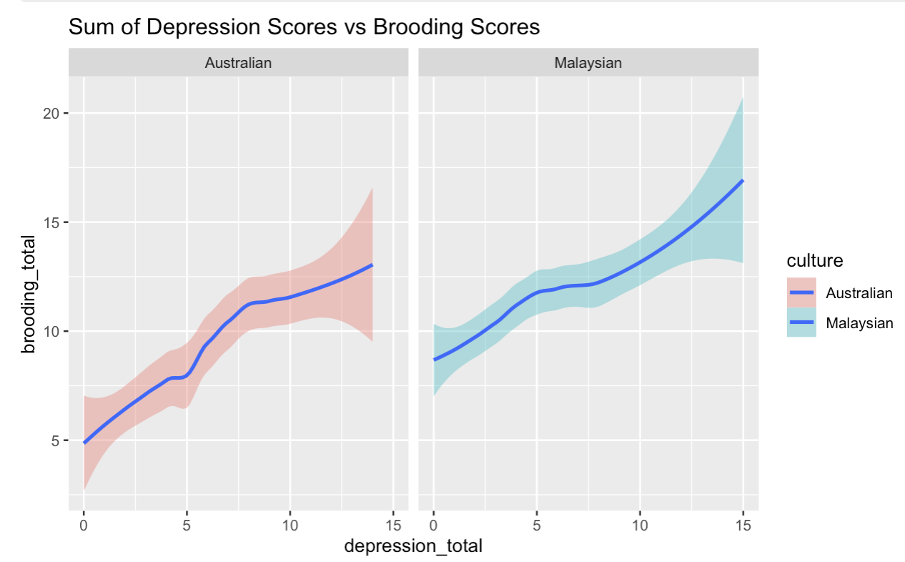
How do Depression scores relate to Brooding scores?
`geom_smooth()` using formula = 'y ~ x'

Slide 14
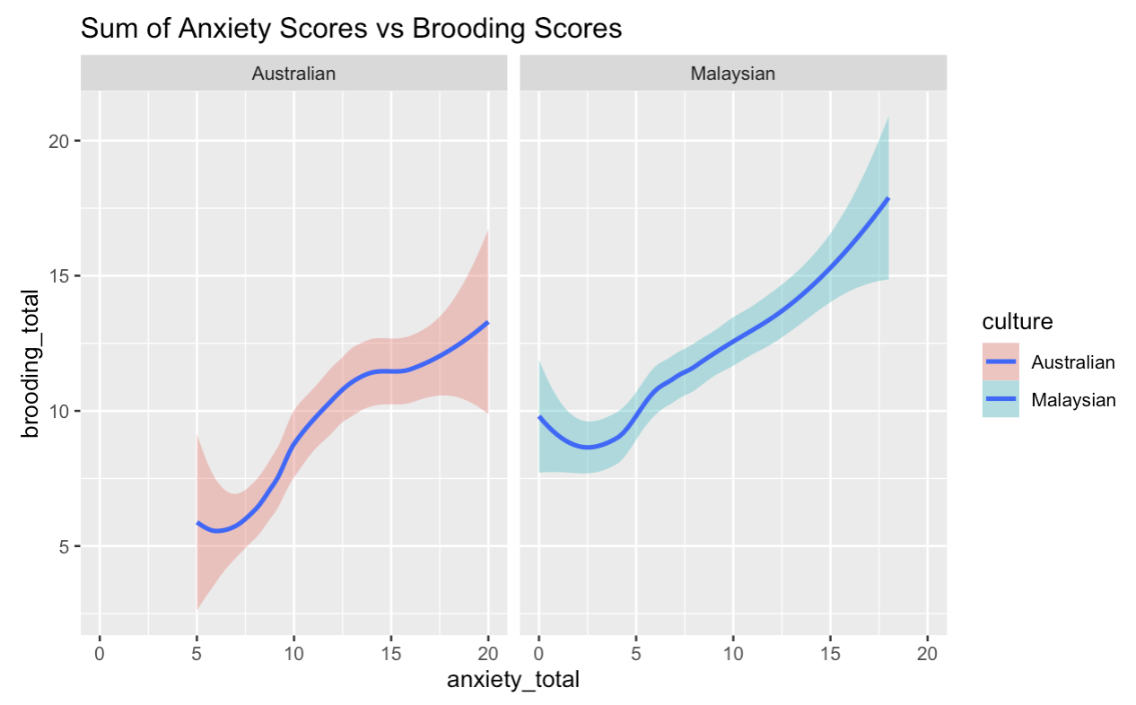
How do Anxiety scores Relate to Brooding scores?

Slide 15
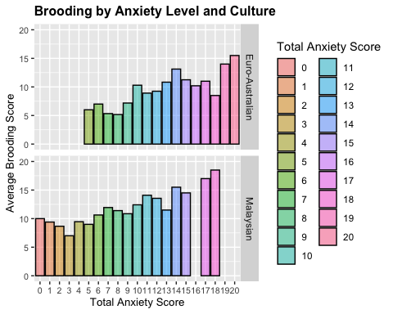
Graphically, how does that compare between cultures?

Slide 16
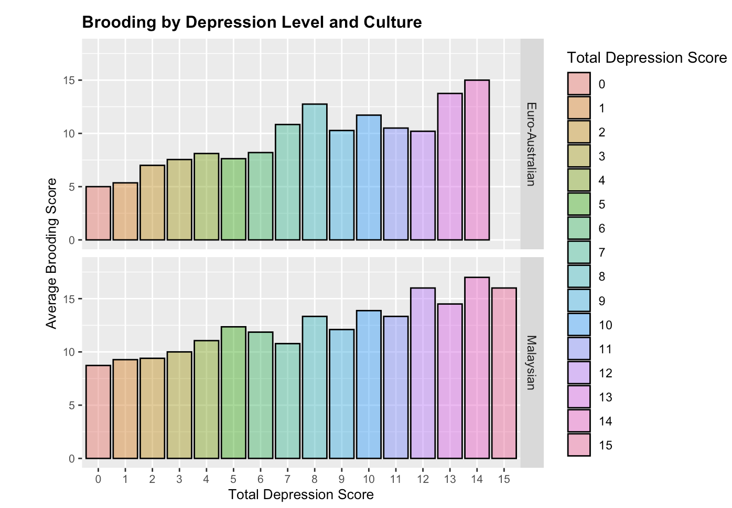
How about depression?

Slide 17
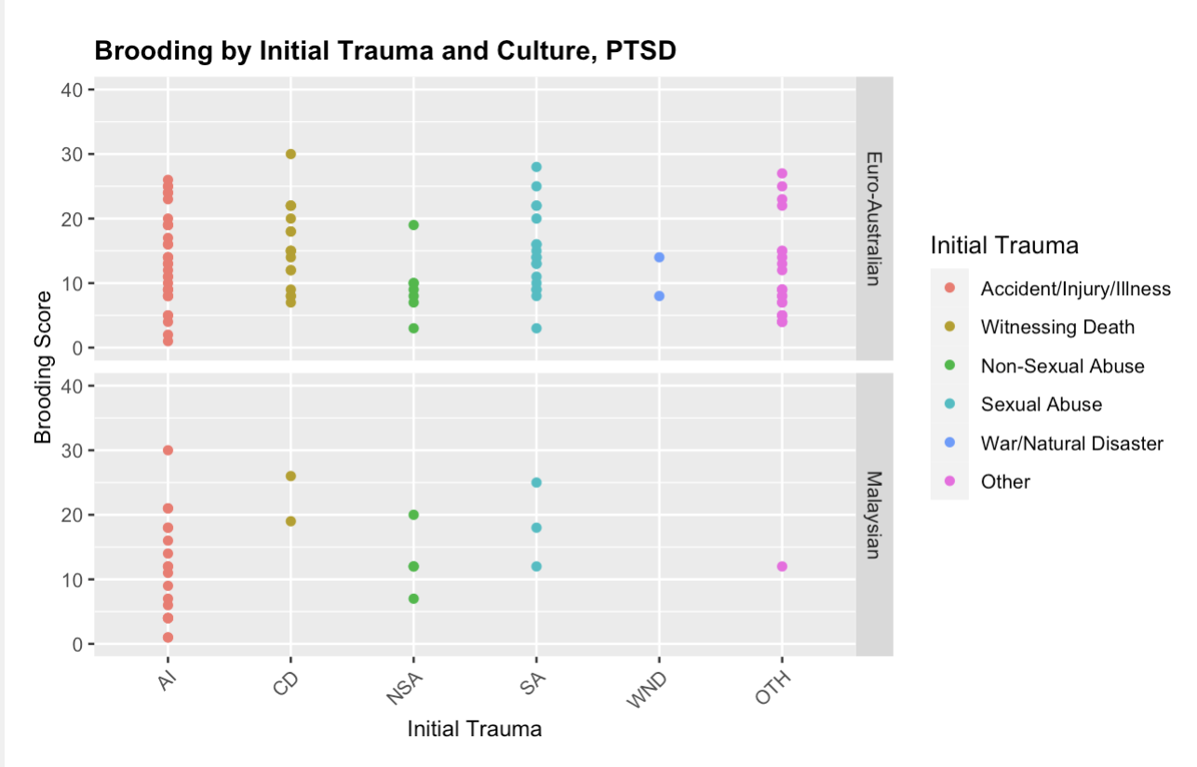
PTSD - Brooding by Initial Trauma & Culture

Slide 18
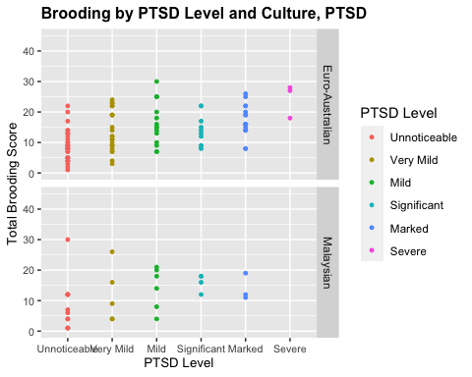
PTSD Level and Culture

Slide 19
Conclusions (Depression)
Women had higher brooding levels overall in both cultures, with Malaysian women scoring higher than Euro-Australian women.
Malaysians with undergraduate degrees had higher brooding levels if they had no religion, were Muslim or Hindu.
Brooding was significantly correlated with anxiety and depression, but culture didn't show significant difference (confirms what paper found)

Slide 20
Conclusions (PTSD)
Largest maximum brooding scores were associated with initial trauma types Accident/Injury/Illness, Witnessing Death and Sexual Abuse for Euro-Australians. There were too few Malaysians to draw conclusions.
Maximum brooding scores were associated with unnoticeable and mild PTSD levels. The maximum for severe PTSD was also high, but there were only three participants at that level.

